Slide 1
Design a Candy Carton
Projector Resources

Slide 2
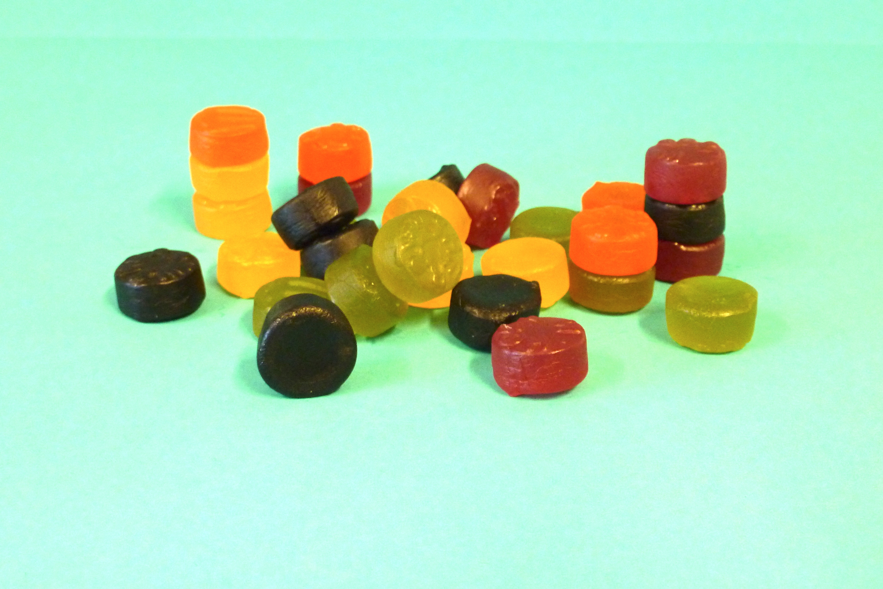
Design a Candy Carton
A candy company wants a carton that will contain 18 candies.
Your design must take into account the following:
The candies are each 1cm deep and 2cm in diameter.
The carton must be made from a net that fits on a single sheet of letter-sized cardboard.
The design should require as little cutting as possible.
The sides of the carton will be fixed together using glue flaps. Show where these will be on your net.
Produce two possible designs for nets of the candy carton.
Compare your two designs. Record in writing which carton you think is best, and why.

Slide 3
A Piece of Candy

Slide 4
Designing a Carton Together
Work in pairs to try to design a better carton than either of you produced individually.
Take turns to explain the work you have done so far. Ask questions if you do not understand the explanation.
Take a few minutes to come up with a joint plan of action.
Make a poster showing the nets of the cartons you design, record all your assumptions and decisions in detail.
Remember – there are lots of different cartons that are good responses to this task.

Slide 5
Sample Responses to Discuss
In your pair, choose one of the Sample Responses.
Read through each Sample Responses together carefully.
Highlight and explain what the student did well.
Highlight and explain what the student could improve.
What questions would you like to ask the student?
When you have worked on one solution, choose another to work on together.

Slide 6
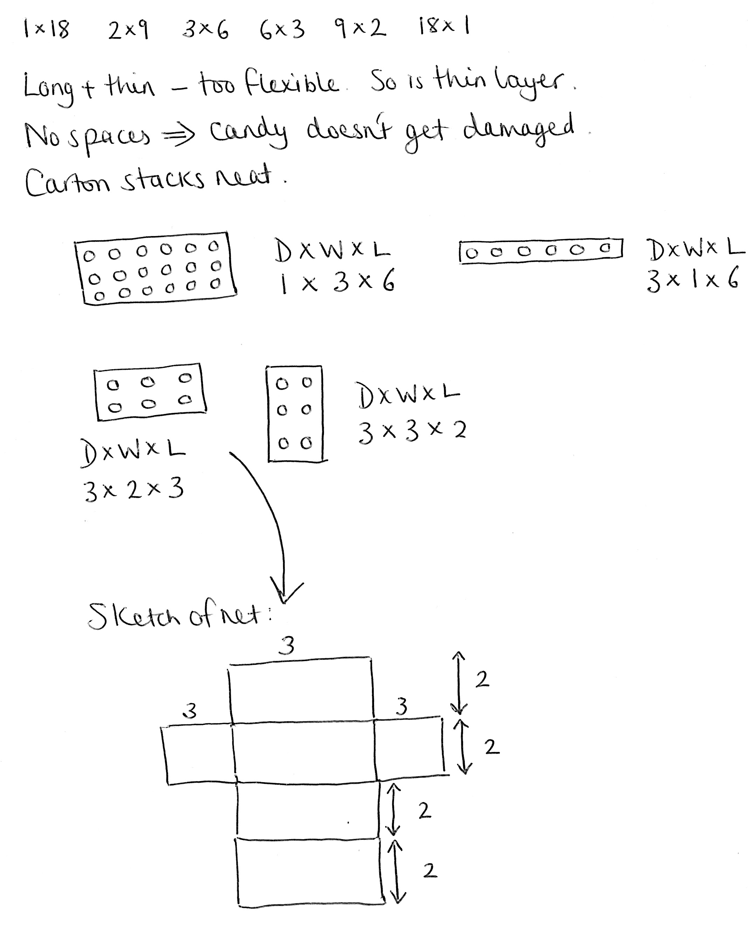
Ewan’s Response

Slide 7
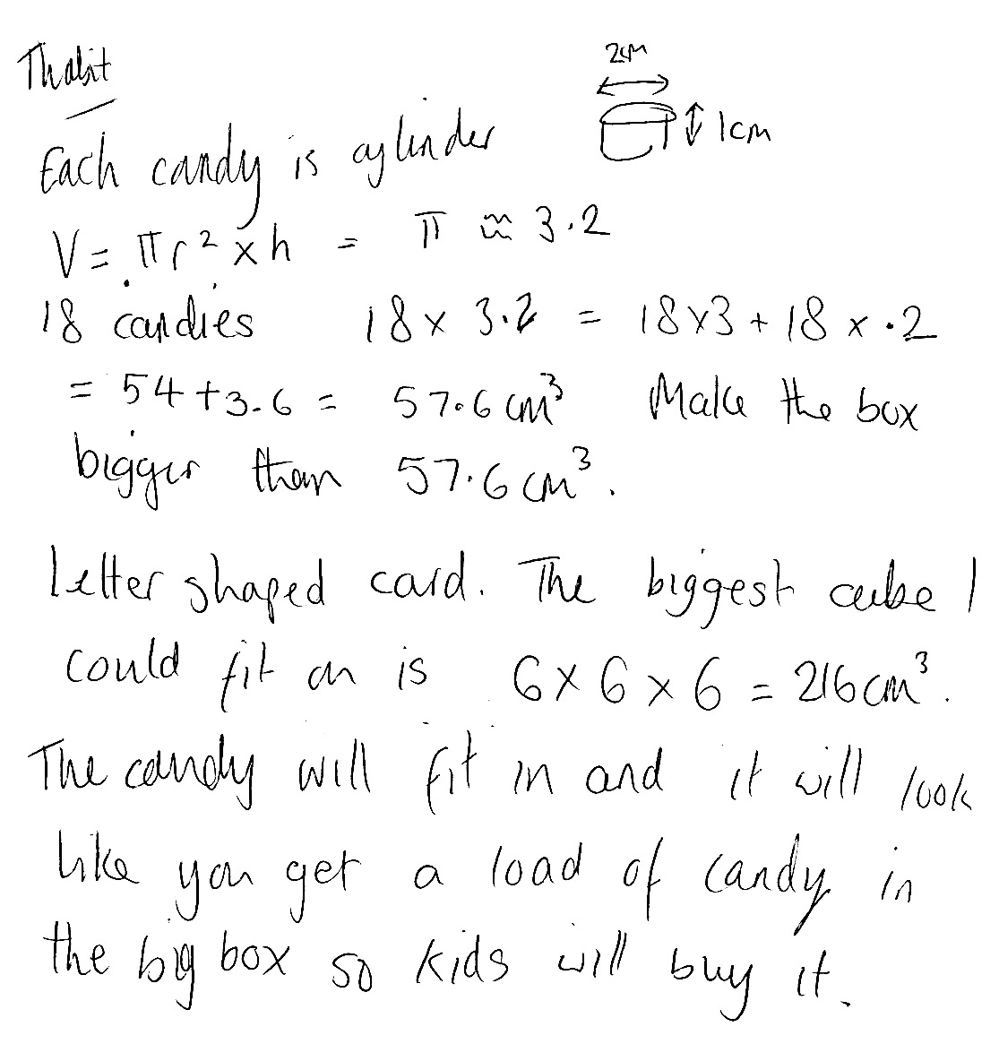
Thabit’s Response

Slide 8
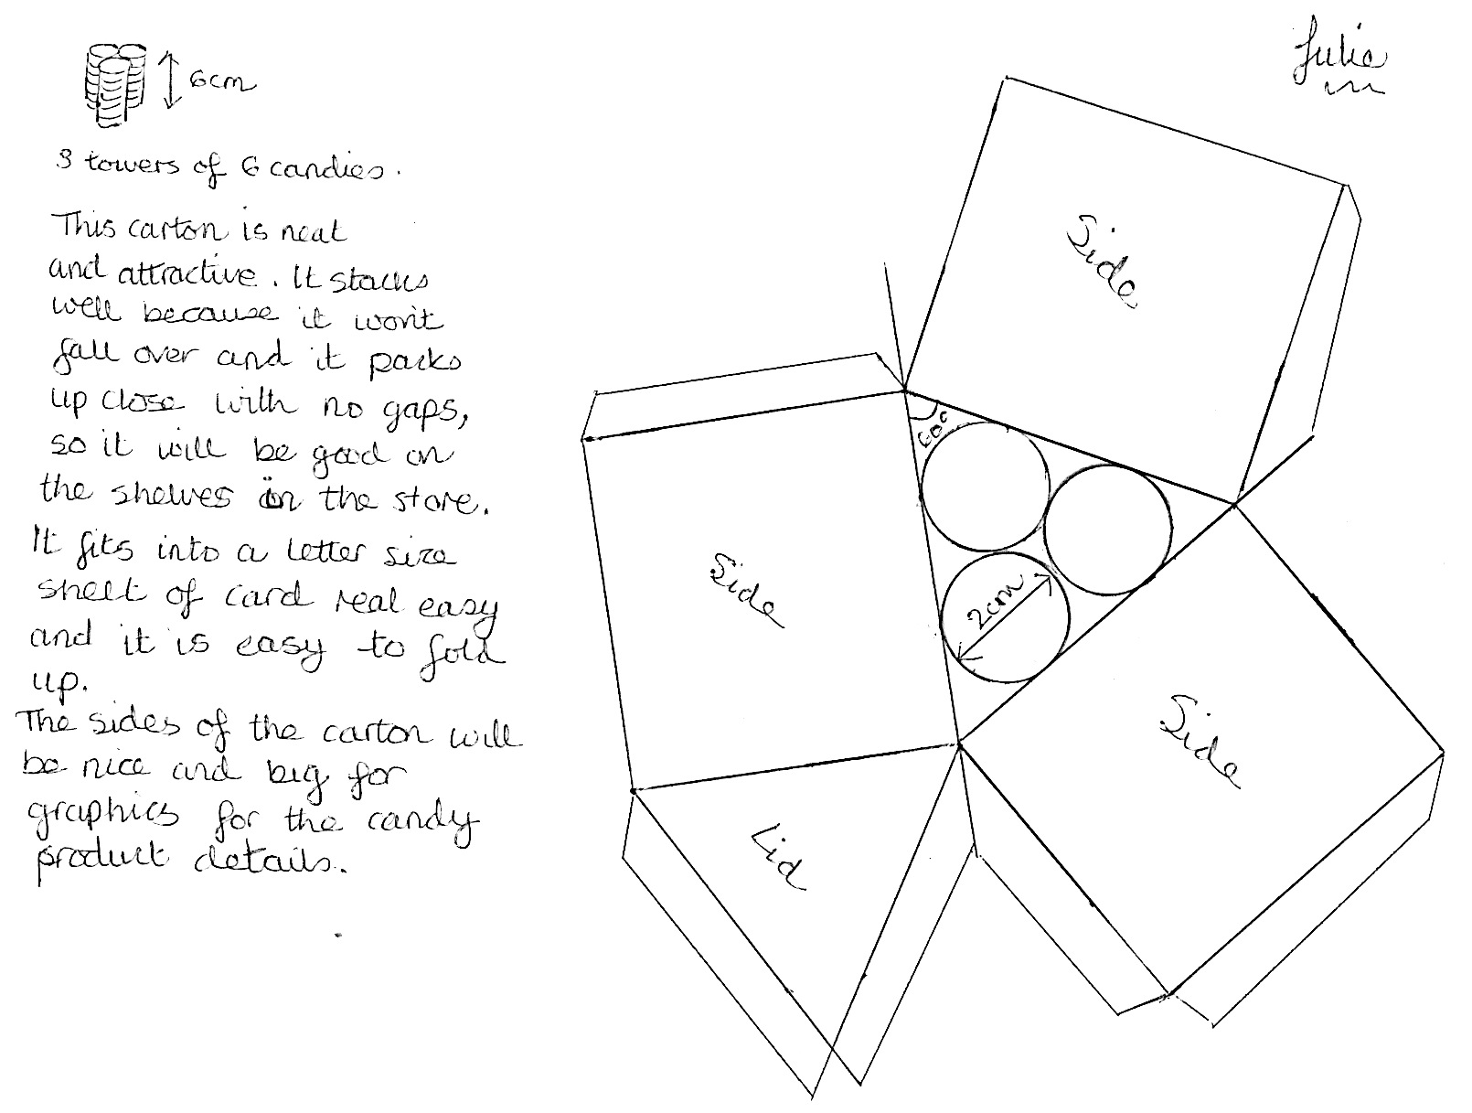
Julie’s Response

